Slide 1

Bus Identification System using RFID RC522
This project aims to develop a bus identification system using RFID technology to assist the visually impaired. The system will provide voice-based announcements of the bus route and destination, enabling blind passengers to navigate public transportation independently.

Slide 2

RFID-based Bus Route Identification and Voice Assistance for the Blind
The proposed system uses RFID technology to detect the bus route and provide voice-based information to passengers. RFID tags installed on buses will be read by an RFID sensor, which will then trigger pre-recorded voice announcements through a speaker module to assist the visually impaired.

Slide 3

Problem Statement
Visually impaired individuals often face challenges when using public transportation, as they are unable to visually identify bus routes and destinations. This can lead to confusion, missed stops, and difficulty navigating the transportation system independently. The goal of this project is to address this problem and enhance the mobility and independence of the blind community.

Slide 4
Existing System
Current bus identification systems often rely on visual displays or written signage, which are inaccessible to the blind. Some systems may use audio announcements, but these are not always reliable or consistent. The proposed solution aims to provide a more robust and user-friendly system for the visually impaired to access bus route information.

Slide 5
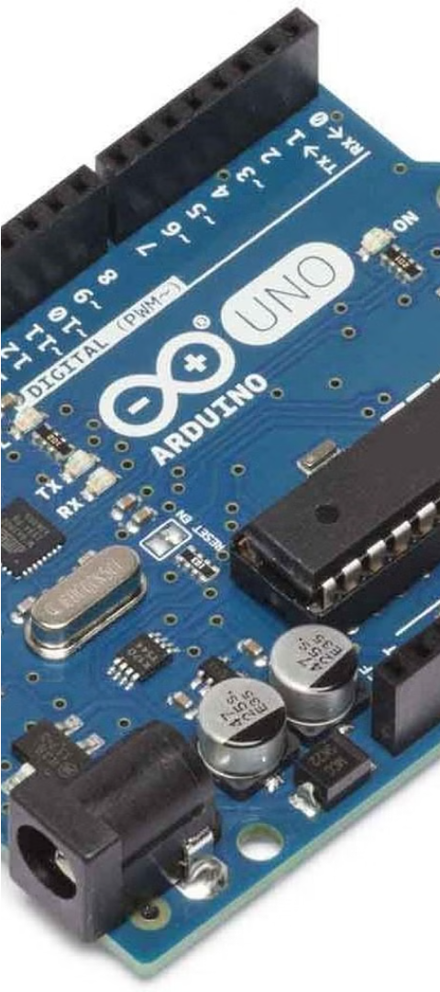
Proposed System
1
RFID Tag Detection
The system will use RFID tags installed on buses to detect the vehicle and its route information.
2
Voice Announcement
An ISD 1820 voice module will be used to play pre-recorded announcements of the bus route and destination.
3
Arduino Integration
The RFID sensor and voice module will be connected to an Arduino Uno board to integrate the system and control the functionality.

Slide 6
Required Components
Arduino Uno
ISD 1820 Voice Module
RFID RC522 Sensor and Tags
The microcontroller board that will integrate the RFID sensor and voice module to control the system.
The voice module that will be used to play the pre-recorded bus route and destination announcements.
The RFID sensor will read the tags installed on the buses to identify the route information.

Slide 7




System Architecture
RFID Tag
RFID Sensor
Arduino Uno
ISD 1820 Voice Module
Installed on the bus to store route information.
Reads the RFID tag and sends the data to the Arduino.
Processes the RFID data and triggers the voice module.
Plays the pre-recorded announcements to assist the visually impaired passengers.

Slide 8
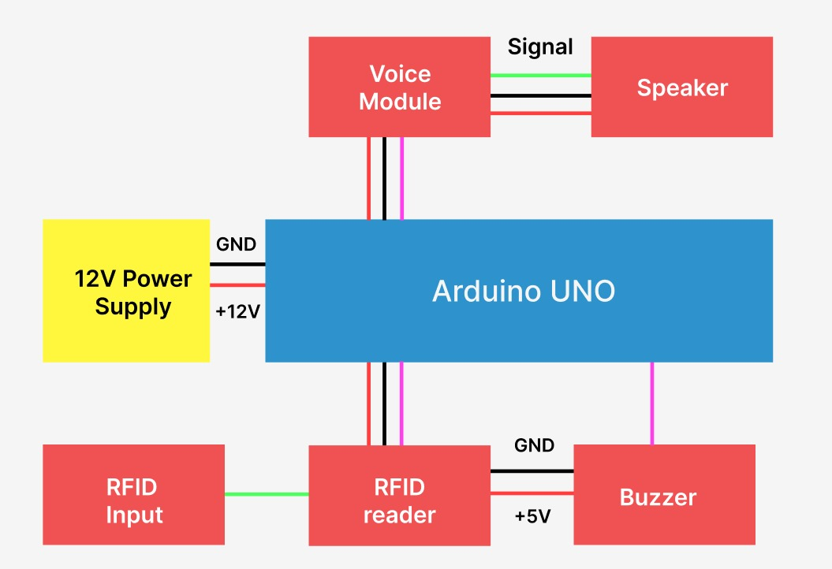
Architecture Diagram

Slide 9

Conclusion
The proposed Bus Identification System using RFID RC522 technology aims to enhance the mobility and independence of visually impaired individuals by providing voice-based announcements of bus route and destination information. This solution will help blind passengers navigate public transportation with greater ease and confidence, improving their overall quality of life.

